Slide 1
Finding Love in University:
A Comparative Study of Japan and the United States
by: Addie Gingold & Lizet Martinez
Advisors: Dr. Yoshiko Saito-Abbott, Dr. Shigeko Sekine

Slide 2
Outline
Significance of the Study
Research Questions
Literature Review
Research Method
Findings
Conclusion and Discussions
Limitations of the Study
Future Studies
Bibliography
Acknowledgements

Slide 3
Significance of the Study
Lizet
While in Japan I had the opportunity to take a class focused on women in Japanese society, it was in this class that I came across the term 合コン (Group style date)
At this time I began to wonder what other differences there are between Japan and America’s dating practices
In this study I hope to discover unique dating practices in Japan and America that reflect societal values
Notes:
focus on= 焦点（しょうてん）をおく
日本社会における女性の役割（やくわり＝role）に焦点をおいた授業=class focused on women in Japanese society
恋愛事情（れんあいじじょう）= dating practices
明（あき）らかにする=discover
日本とアメリカ独自（どくじ=unique）の恋愛事情＝unique dating practices in Japan and America につて明らかにしたいと思います。
社会的価値（しゃかいてきかち=societal values）

Slide 4
Significance of the Study
Addie
As a part of an international relationship, while in Japan I was often asked how my culture and my partner’s culture influenced how we built our relationship (告白, meeting families, etc)
In order to avoid any social taboo, I consulted my Japanese peers about cultural nuances that affect general dating situations

Slide 5
Research Questions
What are students perceptions on college dating in Japan and America, and how does this affect how they find a partner?
How do dating practices differ between Japanese and American students as they balance dating and their studies?
What factors contribute to a student's desire to continue a relationship?

Slide 6
Literature Review Outline
Dating values
Six types of love
Dating concepts
How relationships begin
Developing a serious relationship
Difference of “Like” and “Love”
Social influences
School and dating

Slide 7
Dating Values
Extrinsic values
standard of right and wrong
practical application of values
e.g. Society would see promiscuity in females as a negative value (wrong)
Intrinsic values
values based on personal experience, everyday behavior
e.g. Women whom refrain from sexual activities may be seen as prudish (another negative) by some men
(Turner, 2013)

Slide 8
6 Types of Love
Love can be categorized based on multiple viewpoints
Emotions and desires for one's partner
Mutual hopes and expectations
Whether the romantic relationship is long-term or short-term
Primary Types
Eros (passionate love)
Storge (fraternal love)
Ludus (playful love)
Composite Types
4. Mania (fanatic love)
5. Pragma (sincere love)
6. Agape (benevolent, altruistic love)
(渋谷昌三、2013)

Slide 9
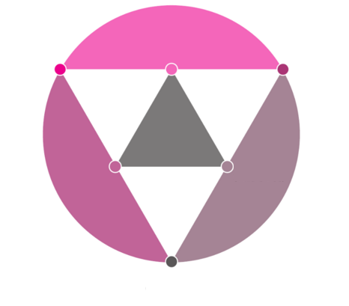
Love Matrix
From the primary types (Eros, Storge, and Ludus), the secondary types (Mania, Pragma, Agape) are created
The presence of all points in a relationship is seen as holistic
Eros
(passionate love)
4. Mania (fanatic love)
3. Ludus
(playful love)
6. Agape
(benevolent,
altruistic love)
5. Pragma
(sincere love)
2. Storge
(fraternal love)
(Lee, 1988)
(渋谷昌三、2013)
Notes:
This chart indicates the primary and secondary points of love. As you can see, when two primary point mix they create a secondary point. When all points are present in a relationship it is seen as holistic.

Slide 10
How Relationships Begin
Japan | United States
合コン goukon: “combined party,” for men and women to become acquainted | Hook-up: physical intimacy without emotional attachment
告白 kokuhaku: Confession of love; done before the start of a romantic relationship. | Casual dating: a physical and emotional relationship between two people without the commitments of a more formal romantic relationship
(Bogle, 2008)

Slide 11
Developing a Serious Relationship
紹介 syoukai: the introduction to one's family
Committed Relationship: an emotionally invested relation between people
Cohabitation: Moving in together
(Bogle, 2008)

Slide 12
Differences Between “Love” and “Like”
Japanese people use the term 好き suki
e.g. to a prospective partner, “I like you”
Americans use “love” and “like” more interchangeably
e.g. (When you receive a gift from a friend) “I love that!/I love you!”
Japanese 愛している aishiteiru is a phrase exclusively for loved ones
(Kanemasa, et al., 2004)

Slide 13
Social Influences (Japan)
内外 uchi to soto: concept of dividing people into “inner” and “outer” groups. The limitations of “inner” and “outer” depend on background circumstances.
甘え amae: to be liked by those around you, the feeling of being able to depend on others, to count on the goodwill of people
(Doi, 2001)

Slide 14
Social Influences (United States)
No Strings Attached: indifferent relationship ending without complicated/annoyed feelings, lingering affection, or remorse
The American Dream: many Americans base a happy, successful life on having children, a partner, and a home
(American Psychology Association, 2013)

Slide 15
School and Dating (Japan)
Myths
“...46 percent of women between the age of 16 to 24 despise sexual contact. And 25 percent of the guys in that same age…"
(Aziz Ansari, 2015)
Reality
37.6% of singles say they don’t want a romantic partner
60.8% voiced interest in romantic relationships
86.3% of men and 89.4% of women still said they "intend to marry some day"
(Japan times, 2015)

Slide 16
School and Dating (United States)
Myths:
“College students prefer short-term, casual relationships over long-term relationships because it allows them to focus on their academic and career goals.”
(Heather Fishel, 2010)
Reality:
32.5% of college relationships are long-distance (Statistic Brain)
25% of college Seniors are virgins (USA Today)
1/3 of college Seniors have been on fewer than two dates (Independent Women's Forum)

Slide 17
Research Method
Study Participants
160 university students
80 Japanese (50 female, 30 male)
80 American (50 female, 30 male)
Research Instrument
Online Survey (Google Forms)
Japanese, English
Notes:
Link survey and show survey~

Slide 18
Research Findings 1
Research Question 1:
What are students perceptions on college dating in Japan and America, and how does this affect how they find a partner?

Slide 19
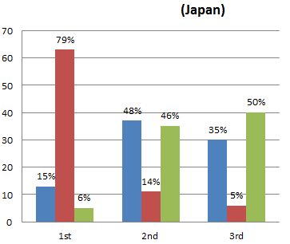
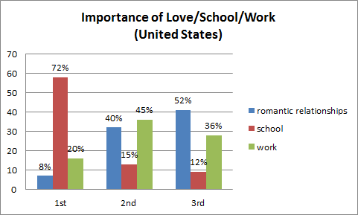
Importance of Love/School/Work
Both groups prioritize their schoolwork overall, but Japanese prioritize love before work, while Americans still prioritize work before romantic relationships.

Slide 20
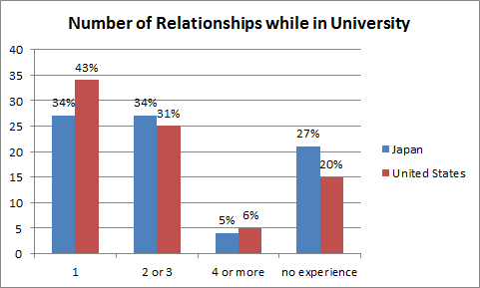
Number of Relationships While in University
There is no major difference between Japanese and American students regarding past relationships, but more Japanese students have no prior dating experience.
Notes:
Color key words

Slide 21
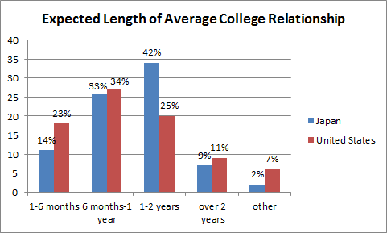
Expected Length of a College Relationship
Japanese students were more likely to expect longer relationships (1-2 years), whereas Americans preferred shorter ones (6 months-1 year).
Notes:
Add slide for second graph
have / expect

Slide 22
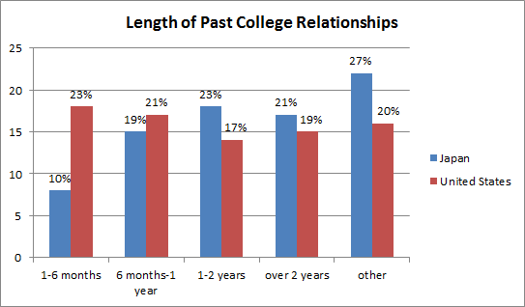
Length of Your Past Relationships while in University
Japanese students were more likely to have longer relationships (1-2 years), whereas Americans preferred shorter ones (6 months-1 year).
Notes:
Add slide for second graph
have / expect

Slide 23
Research Question 1
Summary of Findings
Both groups of students prioritize their schoolwork over romantic relationships
American students prioritize love less than Japanese students
Americans expected/experienced shorter relationships, whereas Japanese expected/experienced longer ones
Nearly ⅓ of Japanese students have never been in a relationship, but there wasn’t any major differences from Americans

Slide 24
Research Findings 2
Research Question 2:
How do dating practices differ between Japanese and American students as they balance dating and their studies?

Slide 25
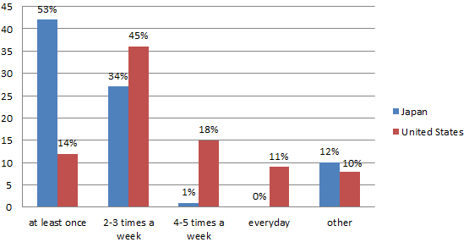
Expected Number of Times to Meet a Partner per Week
Compared to about half of Japanese students answering “at least once”, nearly half of Americans answered “2~3 times”, meaning they need to meet partners more often.

Slide 26
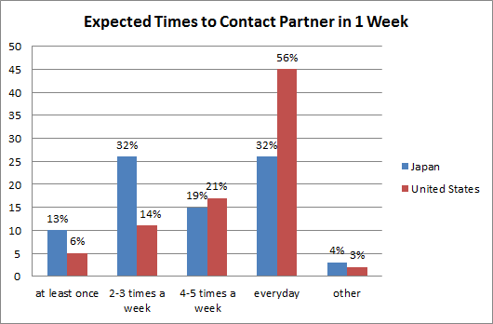
Expected Number of Times to Contact a Partner per Week
Compared to 32% of Japanese students, 56% of American students said that they expect to contact their partner everyday.

Slide 27
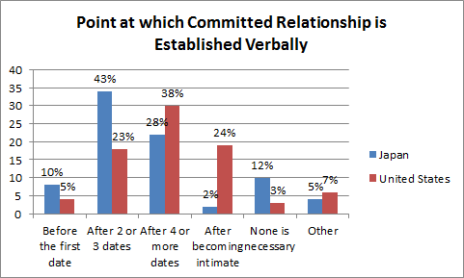
Point at Which Verbal Establishment is Necessary
Japanese students preferred verbally establishing a committed relationship earlier (after 2~3 dates).

Slide 28
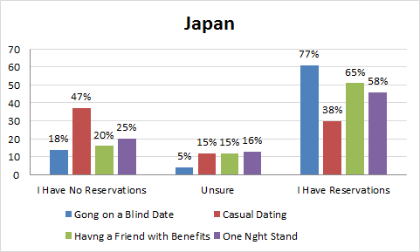
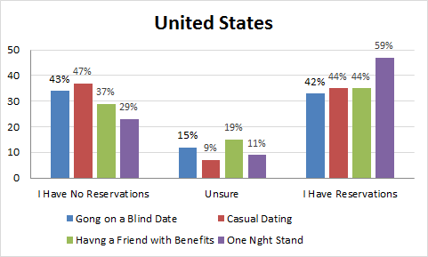
How Much Discomfort do you Have Regarding the Following Types of Dates?
Compared to Japanese, more Americans answered that they do not feel any discomfort regarding these concepts.

Slide 29
Research Question 2
Summary of Findings
More Americans answered that they would meet their partner frequently, and also tended to contact their partner more frequently
Compared to American students, Japanese students prefer establishing relationships earlier, but they still did so later than our previous research suggested
More Japanese students answered that no verbal establishment of a relationship is necessary

Slide 30
Research Findings 3
Research Question 3:
What factors contribute to a student's desire to continue a relationship?

Slide 31
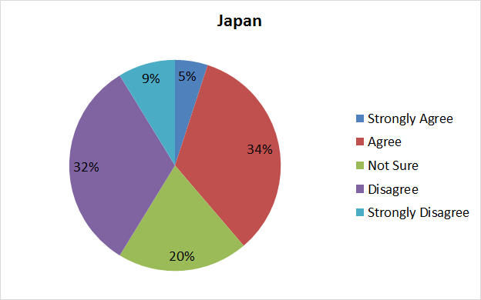
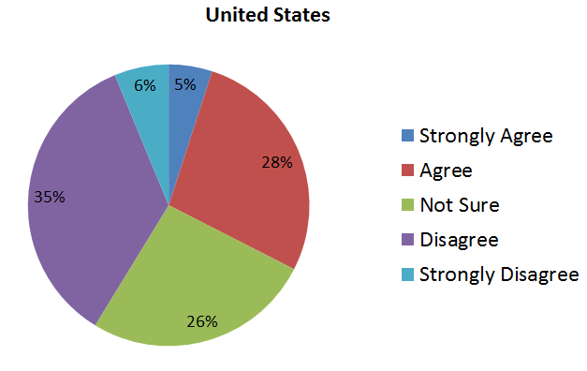
“I will not continue a relationship with someone whom my friends do not approve of.”
Although both Japanese and American students reflect similar responses, Japanese students show a slightly higher regard for their friends opinion.
Notes:
Both groups of students felt nearly the same about how their friends could affect their romantic relationships、 but Japanese students felt a bit more strongly about it.
Although both Japanese and American students reflect similar responses, Japanese students show a slightly higher regard for their friends opinion.

Slide 32
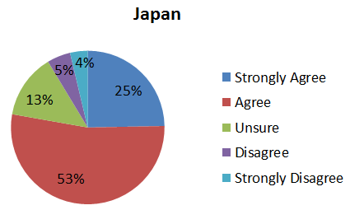
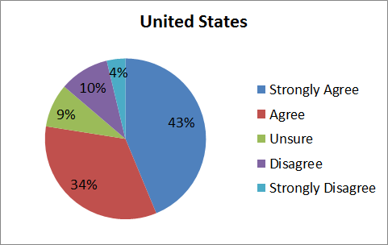
“I believe that going out on dates after you become exclusive with your partner is important to maintain a romantic relationship.”
Although Americans felt more strongly, both groups believe that going out on dates (as opposed to just spending time together) is important for a healthy relationship.
Notes:
Although Americans felt more strongly, both groups believe that going out on dates (as opposed to just spending time together) is important for a healthy relationship.
アメリカ人の方が日本人よりも、(家などで一緒に過ごすだけではなく、)デートに出かけることが健全な関係にとって重要であると感じていたが、日米どちらの学生もそのように思っているようである。

Slide 33
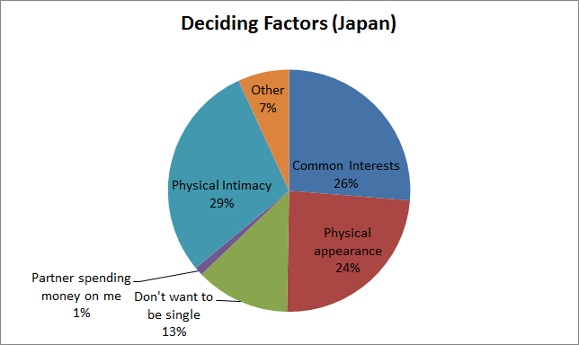
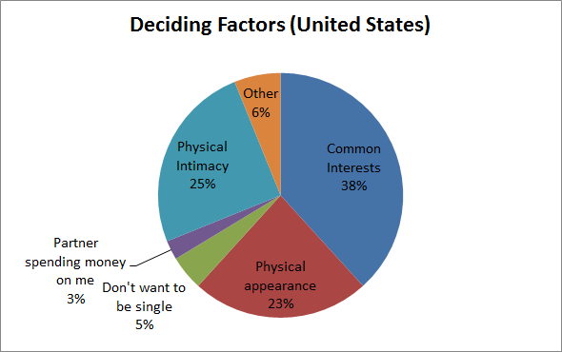
Continuing a Relationship
Contrary to popular belief, in order to continue a serious relationship, Japanese students decided on physical intimacy, whereas Americans chose common interests.

Slide 34
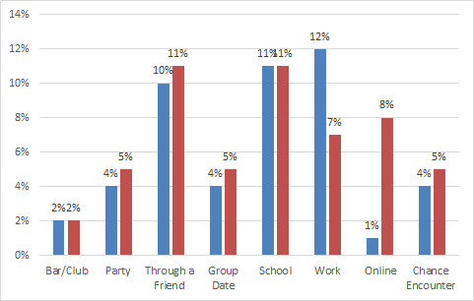
Places to Find a Serious Partner
Americans think that there is a possibility of finding a partner in many locations, while Japanese students chose school or work, but had negative feelings towards online dating.

Slide 35
Research Question 3
Summary of Findings
Japanese and American students prioritize common interests, physical appearance, and intimacy when finding a partner
Japanese students surprisingly ranked physical appearance/intimacy higher than Americans
Both groups prefer finding potential partners at school or through friends, but Japanese students said that there was a high chance of meeting a partner at work
Japanese students opposed online dating, but Americans didn’t want to start relationships in the workplace

Slide 36
Conclusion & Discussion
Difference in goals when starting a relationship
In America, the goal is to find a partner, while in Japan, the goal is to have a long-term relationship
Japanese students are more traditional in terms of relationships
Hesitations in regards to online dating and casual dating.
Compared to Americans, verbally establishing a committed relationship early.
Japanese students see physical intimacy as an important aspect of maintaining a committed relationship
Physical intimacy may be an indication of long term commitment
Notes:
The spread of pop culture influences these new found acceptances for example the introduction of sex friend along with exposure to western films
ポップカルチャーが広まったことがこれらの新しい概念を受け入れるやすさに影響している。例えば、西洋映画によるセフレの概念の導入など。 Difference in the degree of severity Ex: committed relationships, In japan a relationship is inherently seen as committed whereas americans tend to assume things are “casual” until otherwise mentioned. This could be because of the high level of influence from society about matching and loyalty. Japanese people have a tendency to wait longer to start a relationship and therefore by the time they start it they are already committed and past the “just getting to know each other” phase.

Slide 37
Limitations of the Study
Lack of corresponding words in either language
Translation of specific culturally well-known concepts
Varying degrees of severity: Like/love, committed relationship/ready for marriage
Inconsistent geographic location
Majority of Americans are in California, whereas Japanese came from a wider variety of regions
Many Japanese participants had experience abroad, which may have influenced their view on this topic
Notes:
Lack of corresponding words in either language (difficult to translate data due to culturally specific words) Translation of specific culturally well known concepts Degrees of severity Like vs love, Committed relationship Vs Ready for marriage Many Japanese correspondence had experience abroad, this may have influenced their view on this topic

Slide 38
Future Studies
Study of finding love amongst Japanese and American university students who have studied abroad versus students who have never left the country.
Living in foreign country could change person’s approach to dating more directly than observing foreign media embedded with cultural stereotypes
Study of relationships leading to marriage
If Japanese and American relationships share a mutual goal of marriage, we can more easily compare practices and attitudes
Notes:
4-group study (JAPN have/have not studied abroad, USA have/have not study abroad)

Slide 39
Bibliography
Bogle, K. (2008). Hooking up sex, dating, and relationships on campus. New York: New York University Press.
Turner, J. (2003). Dating and Sexuality in America : A Reference Handbook. Santa Barbara, Calif: ABC-CLIO.
Hatfield, E. , & Rapson, R. (1996). Love and Sex : Cross-cultural Perspectives. Boston: Allyn and Bacon.
“Courtship, Japanese-Style | Monterey Bay.” Accessed October 14, 2015. http://xerxes.calstate.edu/monterey/articles/record?id=FETCH-proquest_dll_18950593.
“Cross-Cultural Reliability and Validity of the Revised Conflict Tactics Scales: A Study of University Student Dating Couples in 17 Nations | Monterey Bay.” Accessed October 14, 2015. http://xerxes.calstate.edu/monterey/articles/record?id=FETCH-LOGICAL-c2365-3b95e5263bb187078dcf2da5c76df1b9376144d96cdd4a9c5da48d46e59823b3.

Slide 40
Bibliography cont’d
“Dating and Sexuality in America : A Reference Handbook | Monterey Bay.” Accessed October 14, 2015. http://xerxes.calstate.edu/monterey/books/record?id=77815.
“Dating, Mating, and Marriage | Monterey Bay.” Accessed October 14, 2015. http://xerxes.calstate.edu/monterey/books/record?id=2474.
“Hooking Up : Sex, Dating, and Relationships on Campus | Monterey Bay.” Accessed October 14, 2015. http://xerxes.calstate.edu/monterey/books/record?id=128274.
Ishida, Hiroshi. “The Transition to Adulthood among Japanese Youths: Understanding Courtship in Japan.” Annals of the American Academy of Political & Social Science 646, no. 1 (March 2013): 86–106. doi:10.1177/0002716212465589.
Kito, Mie. “Self-Disclosure in Romantic Relationships and Friendships Among American and Japanese College Students.” The Journal of Social Psychology 145, no. 2 (April 1, 2005): 127–40. doi:10.3200/SOCP.145.2.127-140.

Slide 41
Bibliography cont’d
Lesure-Lester, G. Evelyn. “Dating Competence, Social Assertion and Social Anxiety among College Students.” College Student Journal 35, no. 2 (June 1, 2001): 317.
Letcher, Amber1 amber.letcher@sdstate.edu, and Jasmin2 Carmona. “Friends with Benefits: Dating Practices of Rural High School and College Students.” Journal of Community Health 40, no. 3 (June 2015): 522–29. doi:10.1007/s10900-014-9966-z.
“You Are Cordially Invited to Weddings : Dating & Love Customs of Cultures Worldwide, Including Royalty | Monterey Bay.” Accessed October 14, 2015. http://xerxes.calstate.edu/monterey/books/record?id=49303.

Slide 42
Acknowledgements
Professor Saito-Abbott
Professor Sekine
Friends and family
Mr. Kiyohiro “Sunny” Hirano, Ms. Anri Ookoshi, Ms. Risa Hanazawa, Mr. Rui Ojima
Fellow Capstone participants

Slide 43
Thank you for listening to our presentation!
Do you have any questions?
Notes:
Hearts and pink stuff~~~~~~~~~~~~~~~~~~~~~~~~~~~~~~~~~~~~~~~

